Slide 1
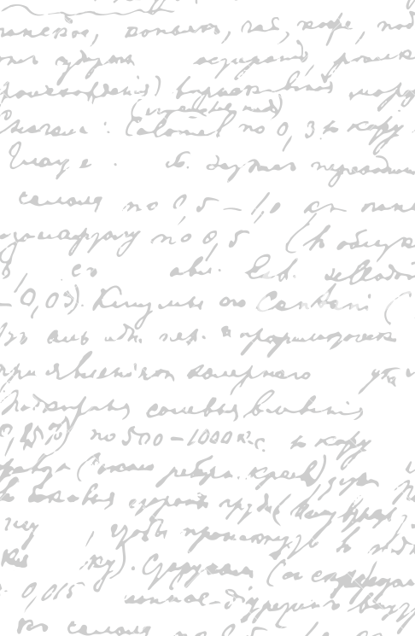

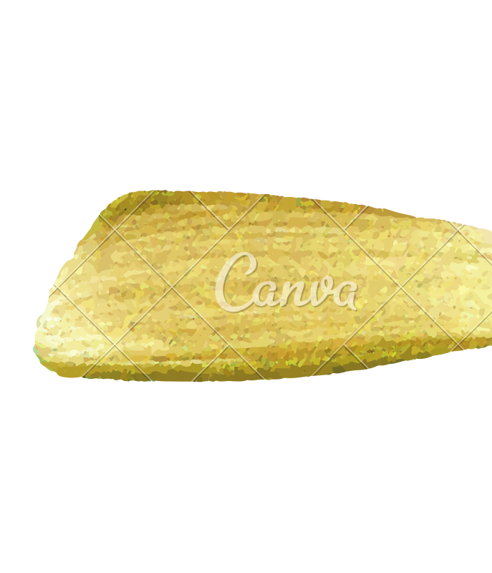

Ming Wu (Andrew) 2133861w
Laser Mate!
Project Supervisor Meeting 9
15 January 2021

Slide 2
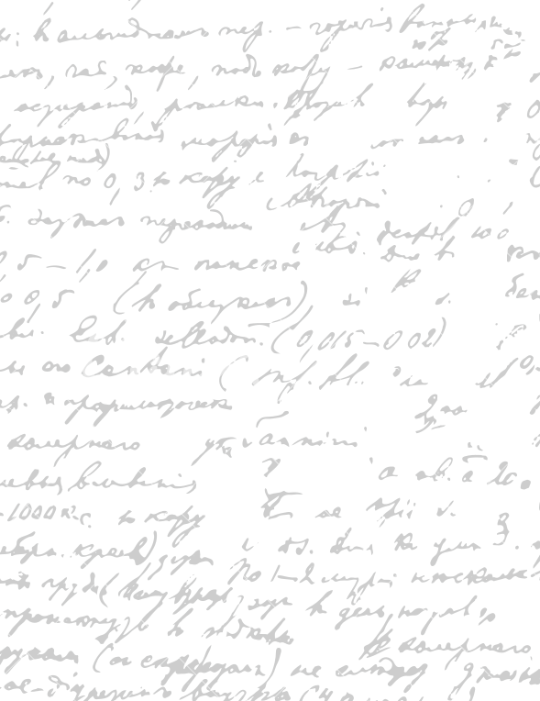



Start Recording

Slide 3
Main Topics
Watch pre-recorded video to refine current product
2. Evaluate and refine digital prototype
3. Future Work

Slide 4
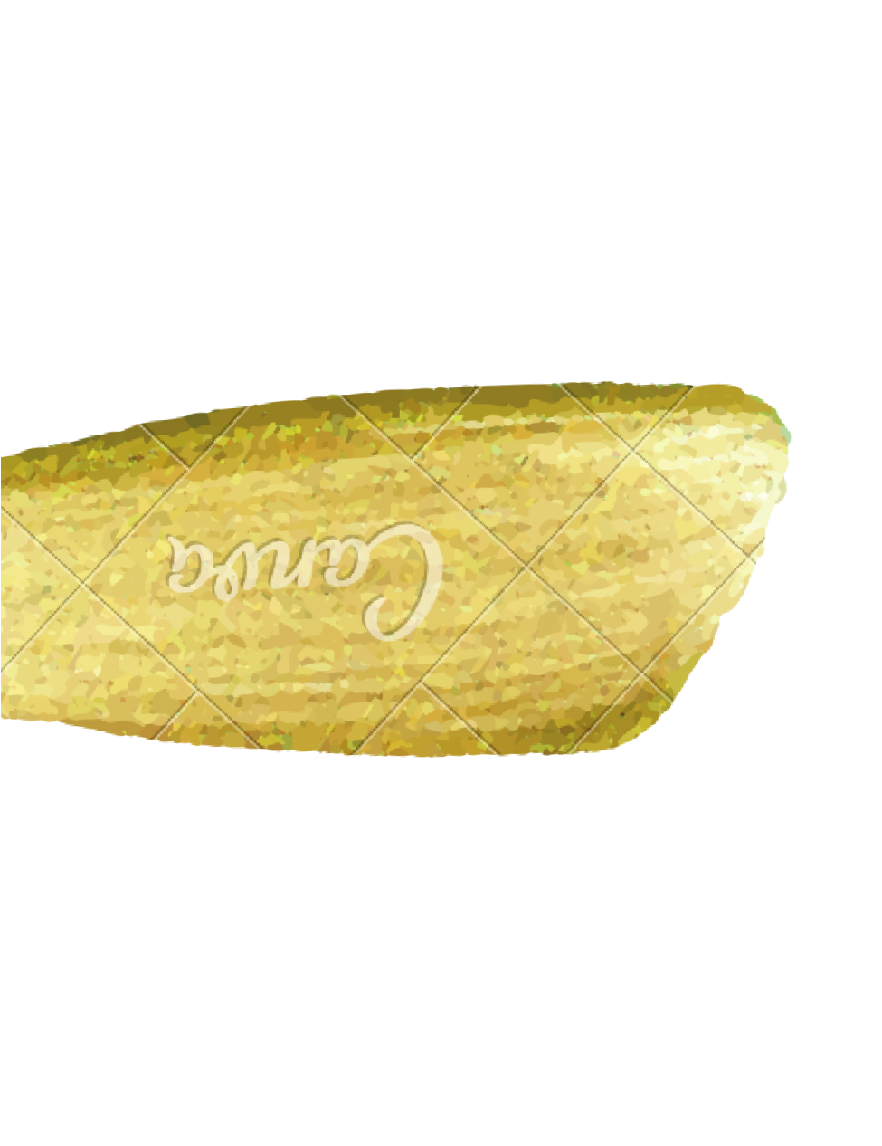
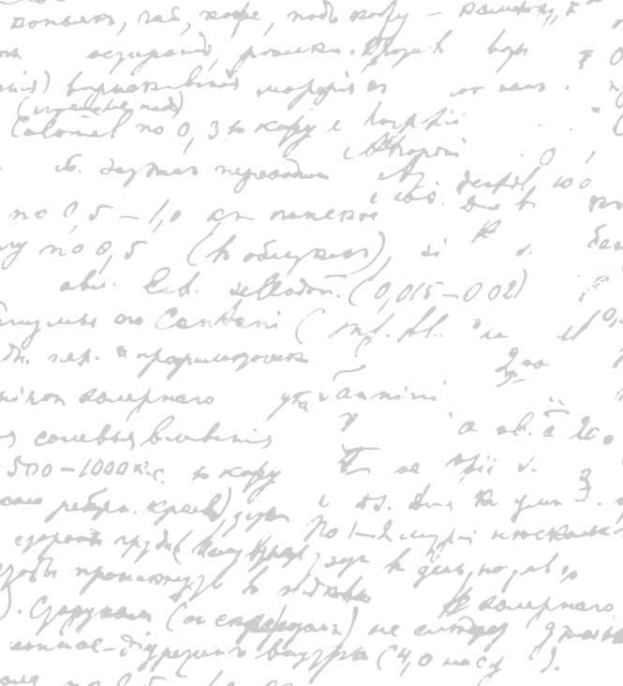

For the current product,
Identify weaknesses and possible solutions
Identify future work
Notes
-
Watch Pre-recorded video to refine current product

Slide 5
For each software part,
- describe why it is a good design; suggest areas of improvement, consider alternative designs.
Colour Scheme/ Contrast
Font Size/ Style
Way of presentation (order of information display)
Word Choice/ image
Icon shape/ size
Spacing/ Proximity between words/images
Software process (how to navigate between pages)
Necessity (whether this part must be present)
What can be added and why
What can be deleted and why
What can be improved and how/ identify the solutions
2. Evaluate and Refine Current Digital Prototype
Plus/ minus order change
Check other platforms

Slide 6
Refine existing test cases
Currently just have a large unstructured document
Refine dissertation
Go through only the most important part of each section of the dissertation
describe what you write and why you write it
Determine whether this section is important to put in
What is missing in this section
What points to delete in this section
Possible writing template/ example work for reference
3. Future Work

Slide 7
Now
Go back to point 2 and evaluate the digital prototype

Slide 8
End

